Slide 1
2-7 ENERGY CO., LLC
Land Support for
Development & Drilling
Upstream Operators | Permian Basin & Lower 48
USMC Veteran-Owned | Fort Worth, Texas | RPL Certified

Slide 2
About 2-7 Energy Co., LLC
2-7 Energy Co., LLC is a Fort Worth, Texas-based land services firm providing subsurface, surface, and development-focused land support to operators, developers, and energy companies across the Lower 48.
RPL
Registered Professional Landman
Founded by land professionals with both in-house operator and brokerage experience, our team understands how land execution directly impacts drilling schedules, infrastructure timelines, and capital deployment.
USMC
Veteran-Owned Business
Be responsive. Solve problems early. Keep projects on schedule.
Lower 48
Nationwide Basin Experience

Slide 3
Land Execution Services
Supporting active drilling programs by aligning land execution with development timelines, engineering plans, and operational priorities.
Leasing & Acquisition
Title & Due Diligence
Negotiation of O&G leases across multiple interest owners; structuring agreements aligned with development objectives.
Ownership verification, title analysis, curative coordination with attorneys to ensure drilling readiness.
Division Orders & Pay Deck
Surface Use & Pad Development
Ownership preparation for revenue distribution; building and validating complex pay decks across multiple interests.
Negotiation of SUAs for drilling locations; pad siting coordination with engineering and operations teams.
Development Coordination
Landowner Relations
Alignment with drilling schedules and development plans; collaboration with engineering, geology, and operations.
Direct negotiation with surface and mineral owners; conflict resolution and long-term relationship management.

Slide 4
Representative Experience
Projects associated with:
Point Energy Partners
Vital Energy
Crescent Energy
Roxo Energy
Leasing & Land Acquisition
Title & Curative
Executed lease campaigns across fragmented ownership; coordinated multi-tract positions for development programs.
Ownership analysis, defect resolution, and coordination with title attorneys for drilling readiness.
Surface Use Agreements
Pay Deck & Division Orders
Negotiated SUAs for drilling locations, facilities, and production infrastructure across Delaware & Midland Basins.
Built and validated complex ownership structures supporting production and revenue distribution.
Broker Management
Development Alignment
Oversight of third-party brokers; quality control and leasing strategy coordination across large acreage programs.
Integrated land execution with drilling schedules, engineering plans, and operational priorities to prevent delays.

Slide 5
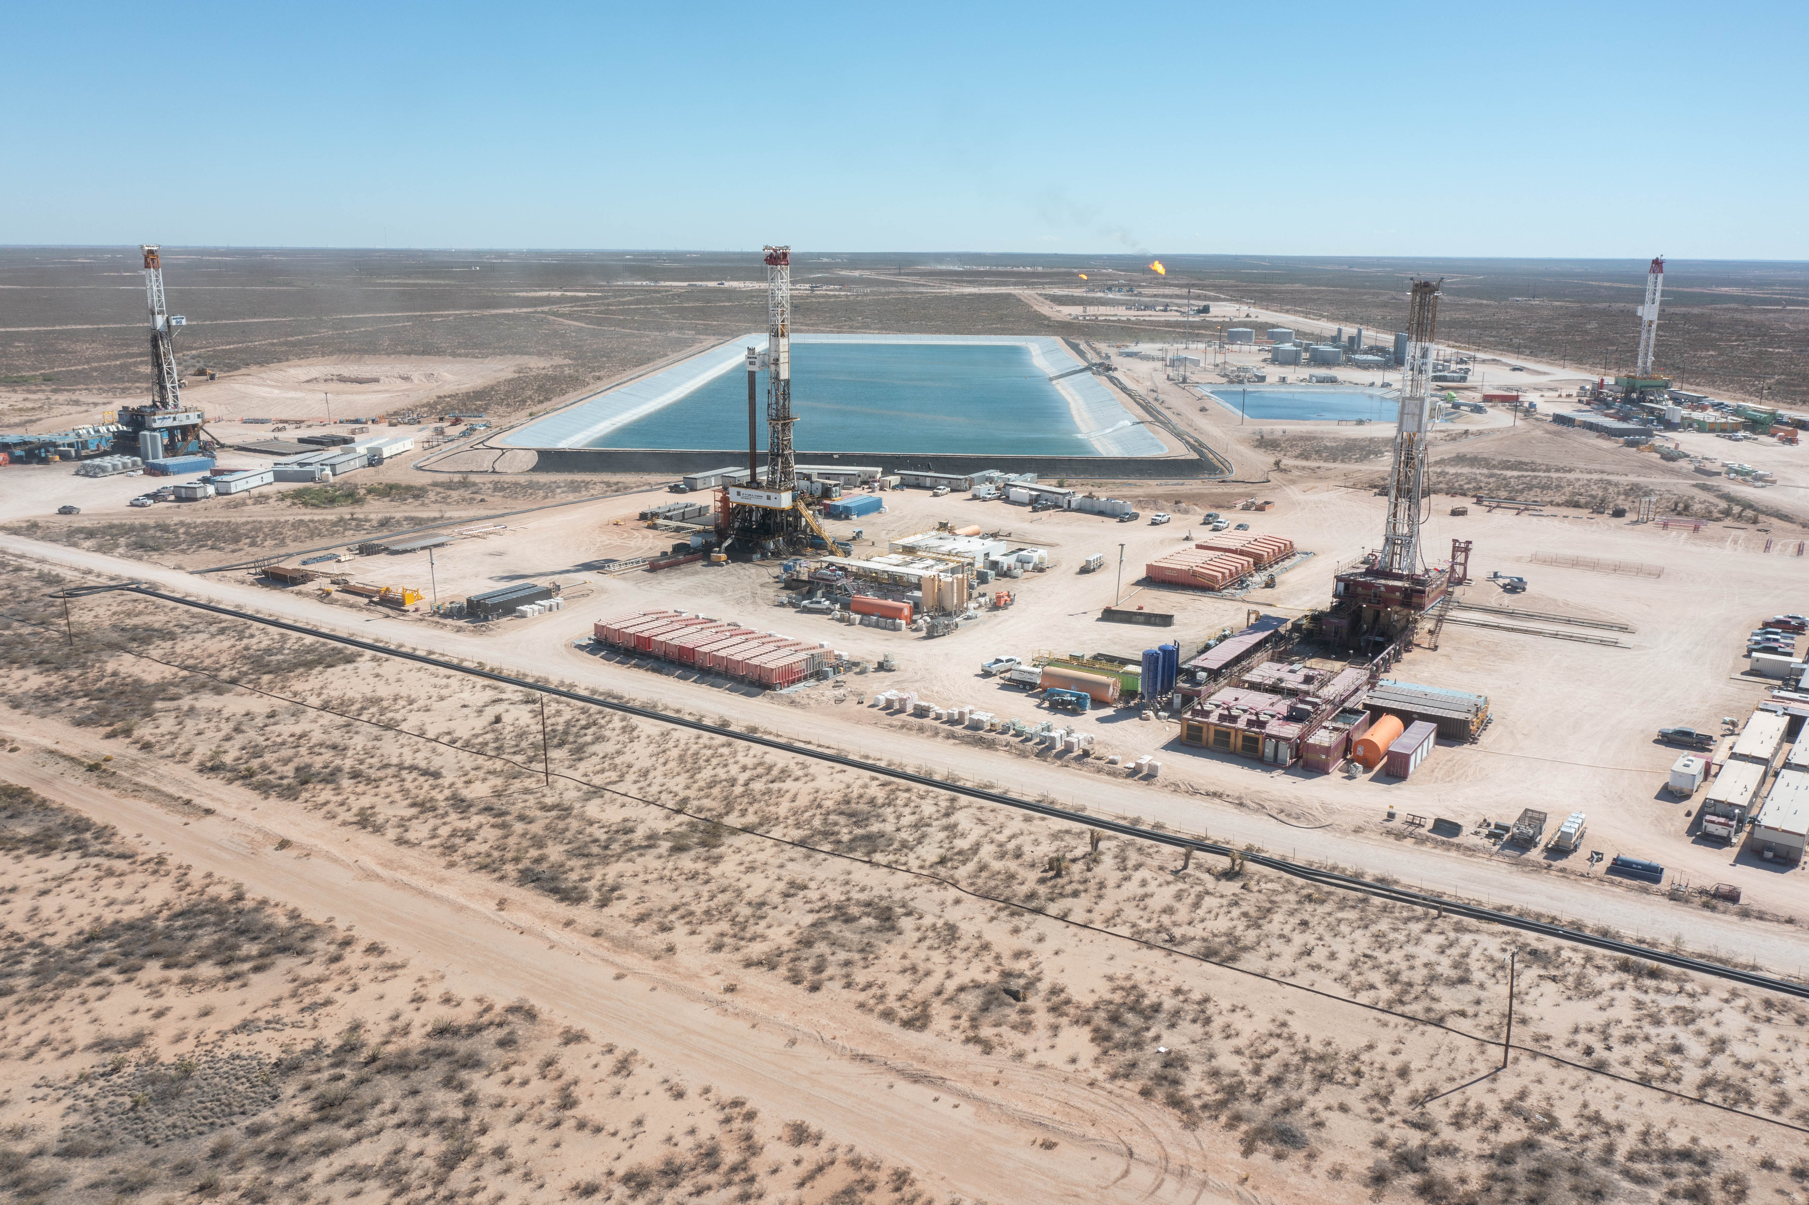
CASE STUDY
Ward County, Texas — Large-Scale Pad Development
Project Overview
— ~350-acre integrated development footprint
— Multi-well pad development program
— Delaware Basin, West Texas
Scope of Work
— Multi-well pad siting and surface agreement negotiation
[ Insert Ward County aerial / site photo ]
— Internal pipeline and flowline corridor coordination
— Electrical easement acquisition for drilling and production
— Produced water pond siting and water transfer line ROW
— Road and access coordination for heavy equipment and operations
Why It Matters
Coordinated full-cycle land execution across a major development footprint
Kept land deliverables aligned with aggressive drilling and completion timelines
Managed competing landowner interests across large surface footprint

Slide 6
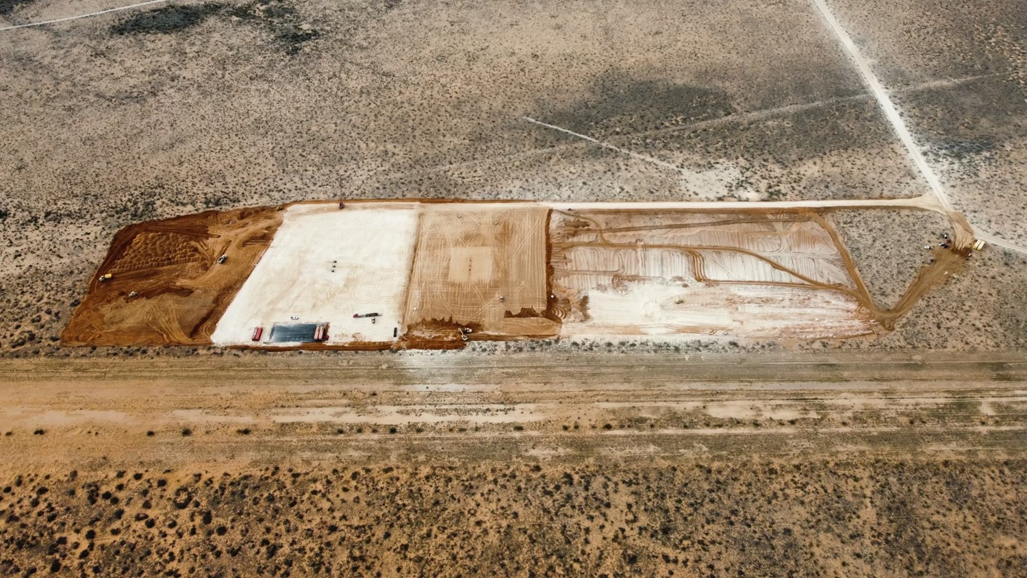
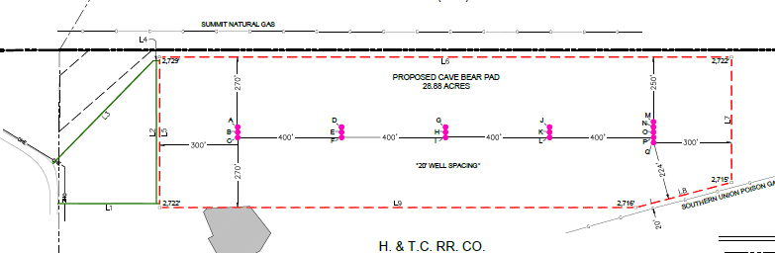
CASE STUDY
Cave Bear — Multi-Well Pad, Pipeline & Electrical
Project Overview
— Multi-well pad development program
— Integrated surface and infrastructure coordination
— Full-cycle land support
Scope of Work
— Surface use agreement negotiation for drilling pads and frac operations
[ Insert Cave Bear site photo / map ]
— Pipeline ROW for gathering lines and produced water transport
— Overhead electrical easements supporting drilling and production
— Broker management and lease negotiation coordination
— Attorney coordination for title and surface curative
Why It Matters
Delivered land agreements aligned with drilling rig schedule
Resolved landowner conflicts without impacting operations timeline
Coordinated across engineering, legal, and operations teams

Slide 7
Why 2-7 Energy?
Operator-Side Experience
Leasing & Title Depth
Field Execution
We've worked inside operating companies — we understand drilling timelines, development sequencing, and what keeps land from becoming the critical path.
Full-cycle capability from lease negotiation through curative — not just order-taking. We own the problem until it's solved.
Hands-on, responsive support for active programs. We step in immediately and integrate with your team.
Landowner Relations
Scalable Support
RPL Certified
Direct negotiation with surface and mineral owners. Clear communication prevents delays and protects schedules.
Project-based or ongoing. We scale to program size — from single-well transactions to multi-county campaigns.
Ivan Toledo holds the Registered Professional Landman designation — a mark of professional and ethical standards in land practice.

Slide 8
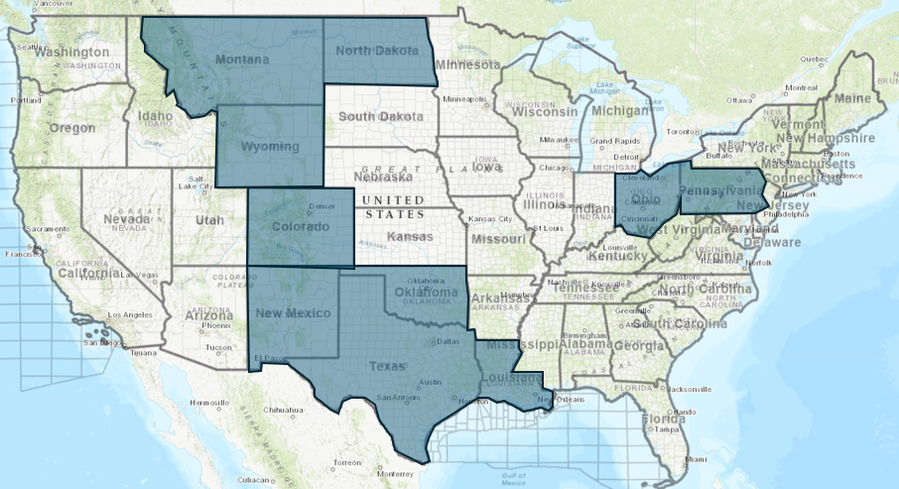
Regional & Basin Coverage
Delaware Basin (Core)
Ward, Reeves, Winkler, Loving Counties
Midland Basin
Midland, Howard, Glasscock, Reagan, Crane, Upton
[ Insert Basin Map — US Onshore Coverage ]
Rocky Mountain
Colorado, Wyoming, Montana, North Dakota
Mid-Continent
Oklahoma, Texas
Appalachia
Pennsylvania, West Virginia, Ohio

Slide 9
Let's Work Together
Areas of Support
Contact
✓ Lease acquisition and negotiation
✓ Title, due diligence, and curative
Ivan Toledo, RPL
✓ Division orders and pay deck support
Founder | 2-7 Energy Co., LLC
✓ Surface use agreements and pad development
Email:
ivan_toledo@2-7energy.com
✓ Landowner negotiations and conflict resolution
✓ Development program coordination
Cell:
682-203-8688
How We Engage
Office:
682-402-5343
1
Identify project needs and timeline
2
Align on scope and support model
Web:
www.2-7energy.com
3
Complete vendor onboarding
4
Execute — integrated from day one
2-7 Energy is available now.
Reach out to align on your next project.

