Slide 1
2-7 ENERGY CO., LLC
Surface & Infrastructure
Land Execution
Midstream | Pipeline | Electrical | Water Infrastructure
USMC Veteran-Owned | Fort Worth, Texas | RPL Certified

Slide 2
About 2-7 Energy Co., LLC
2-7 Energy Co., LLC is a Fort Worth, Texas-based land services firm providing subsurface, surface, and development-focused land support to operators, developers, and energy companies across the Lower 48.
RPL
Registered Professional Landman
Founded by land professionals with both in-house operator and brokerage experience, our team understands how land execution directly impacts drilling schedules, infrastructure timelines, and capital deployment.
USMC
Veteran-Owned Business
Be responsive. Solve problems early. Keep projects on schedule.
Lower 48
Nationwide Basin Experience

Slide 3
Surface & Infrastructure Services
Coordinating land, ROW, and surface agreements for pipeline, electrical, water, and facility infrastructure projects across the Permian Basin and beyond.
Pipeline Right-of-Way
Flowline Coordination
ROW acquisition for gathering lines, transmission corridors, and produced water pipelines. Route planning and landowner negotiation.
Internal flowline routing between wells and production facilities; coordination with development engineers for optimal routing.
Electrical Easements
Water Infrastructure ROW
Overhead and underground electrical easements supporting drilling, compression, and production operations.
Surface agreements and ROW for produced water ponds, frac water transfer lines, and SWD facility siting.
Facility & Pad Siting
Access & Logistics
Surface agreements for compressor stations, processing facilities, and multi-well pad developments.
Road and access corridor coordination for construction, heavy equipment, and ongoing operational traffic.

Slide 4
Representative Experience
Projects associated with:
Point Energy Partners
Vital Energy
Crescent Energy
Roxo Energy
Pipeline ROW Acquisition
Electrical Easements
Secured ROW for gathering lines transporting oil, gas, and produced water across large development footprints in Ward and Reeves Counties.
Coordinated OHE easements supporting drilling rigs and production operations; aligned with power provider routing requirements.
Water Infrastructure
Surface Use Agreements
Sited and secured surface agreements for lined produced water ponds and frac water transfer pipeline corridors.
Negotiated SUAs for multi-well pads, compressor stations, and production facilities across Delaware Basin programs.
Route Adjustments & Conflicts
Cross-Functional Coordination
Managed real-time route changes, surface conflicts, and landowner disputes without impacting construction timelines.
Worked directly with engineers, construction teams, and operations to keep infrastructure buildout on schedule.

Slide 5
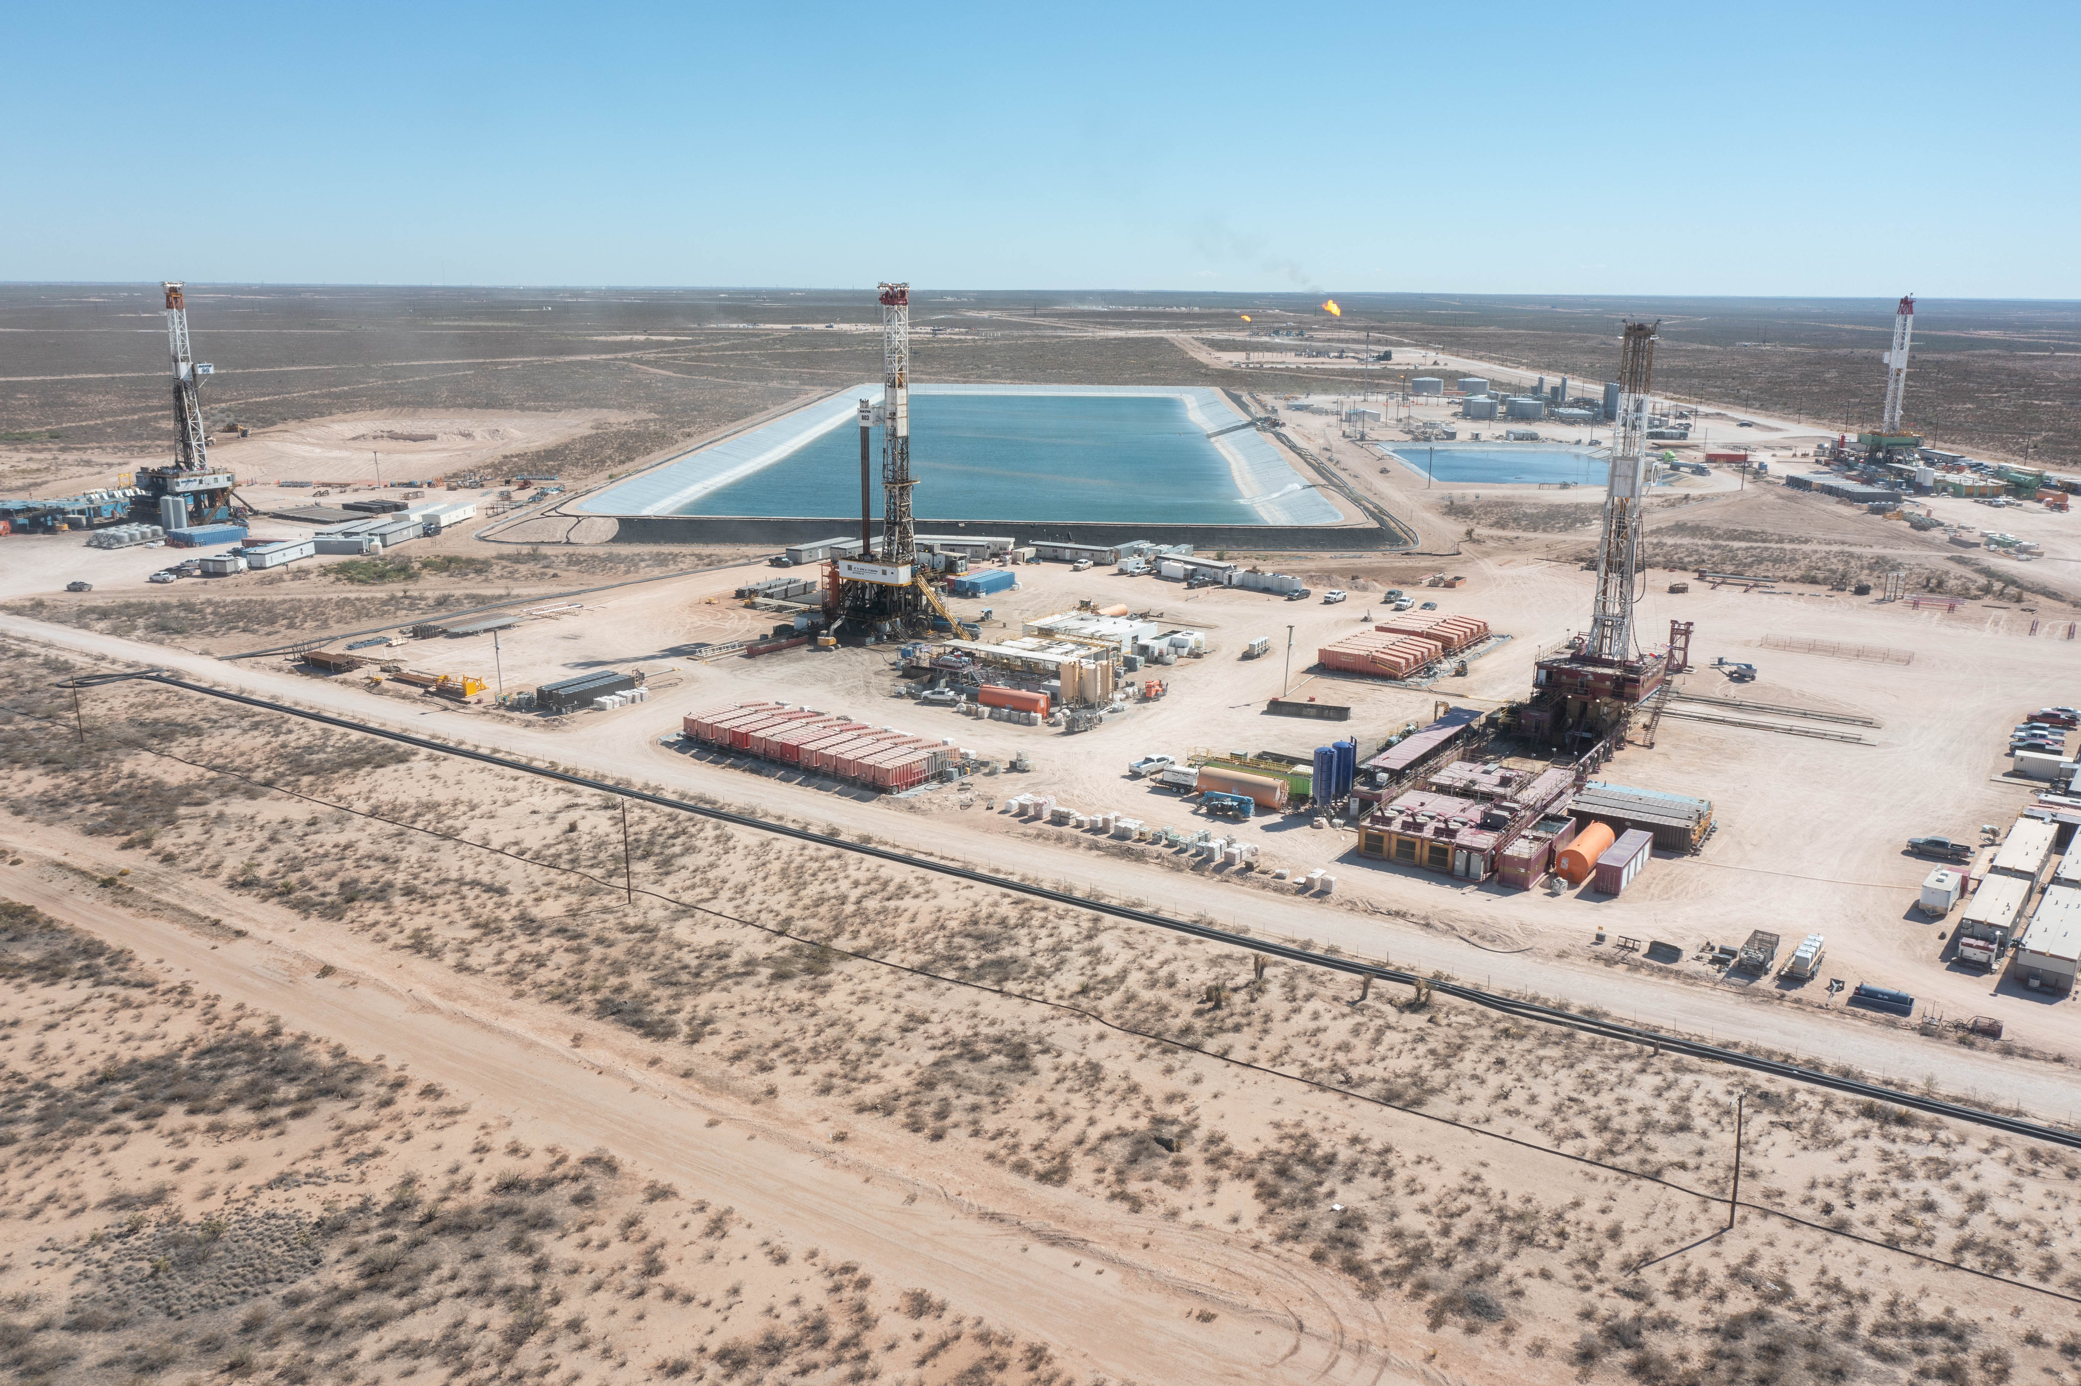
CASE STUDY
Ward County — Integrated Infrastructure Buildout
Project Overview
— ~350-acre development footprint, Section 51, Ward County
— Multi-well pad program with full surface infrastructure
— Delaware Basin, West Texas
Scope of Work
— Pipeline ROW for gathering lines across full development footprint
[ Insert Ward County infrastructure photo / aerial ]
— Internal flowline routing between wells and central production facility
— OHE electrical easements for drilling and production power distribution
— Produced water pond siting and water transfer pipeline ROW
— Surface road and access corridor development for heavy operations
Why It Matters
Full land-to-infrastructure cycle managed in-house — single point of contact
Coordinated five infrastructure types simultaneously without schedule conflict
Maintained productive landowner relationships across large surface footprint

Slide 6
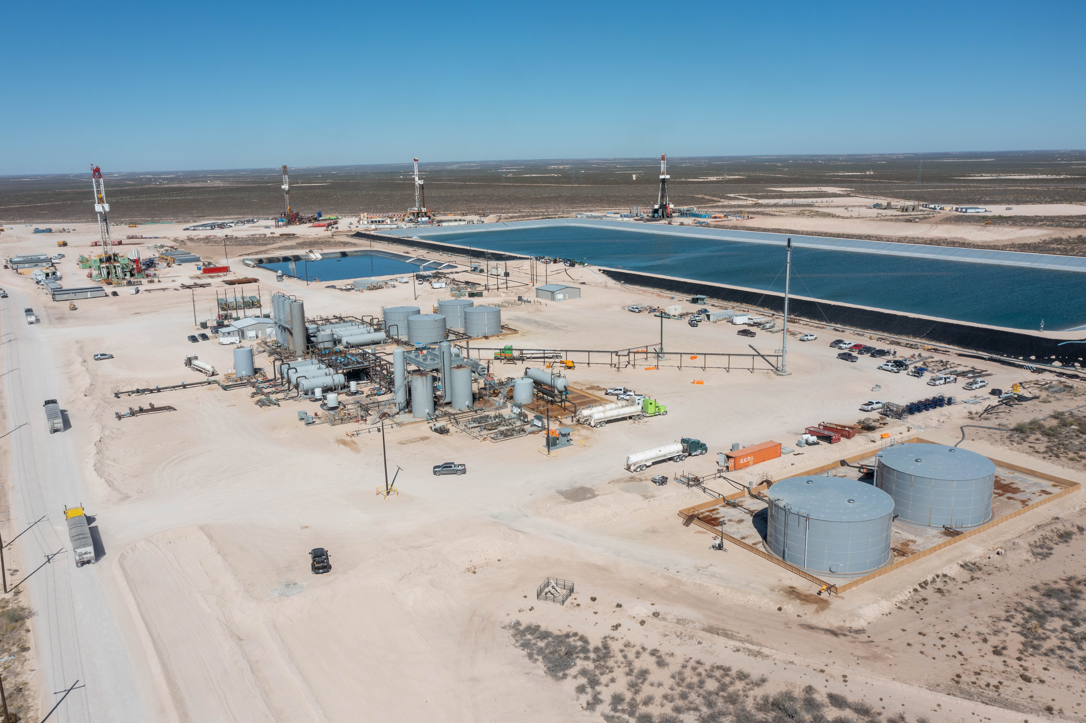
CASE STUDY
Parker Facility — Surface & Infrastructure Development
Project Overview
— Surface facility development with integrated infrastructure
— Multi-component coordination across a concentrated footprint
— Permian Basin
Scope of Work
— Surface use agreement negotiation for facility siting and footprint
[ Insert Parker Facility site photo / map ]
— Utility and access easements supporting construction and operations
— Coordination with engineering on layout, access, and expansion planning
— Landowner negotiation and damage resolution
— Ongoing surface and access support through commissioning
Why It Matters
Delivered all land agreements ahead of construction mobilization
Proactive landowner management prevented delays at a critical project phase
Established relationship framework supporting future facility expansion

Slide 7
Why 2-7 Energy?
Infrastructure-Focused Execution
Operator-Side Background
Field-Level Problem Solving
We've coordinated pipeline, electrical, water, and facility land work simultaneously — we understand how infrastructure types interact and conflict.
Experience inside operating companies gives us a clear understanding of construction sequencing, critical path, and what land issues become operational problems.
Route changes, surface conflicts, and landowner disputes happen. We resolve them in real time — not after they've cost schedule days.
Cross-Functional Coordination
Relationship-Driven
Scalable & Responsive
Direct coordination with engineers, construction teams, environmental, and legal — not just land-to-land communication.
Landowner relationships built on trust and clear communication. We protect the operator's reputation in the communities we work in.
Available now. We integrate with your team immediately and scale support based on program size and complexity.

Slide 8
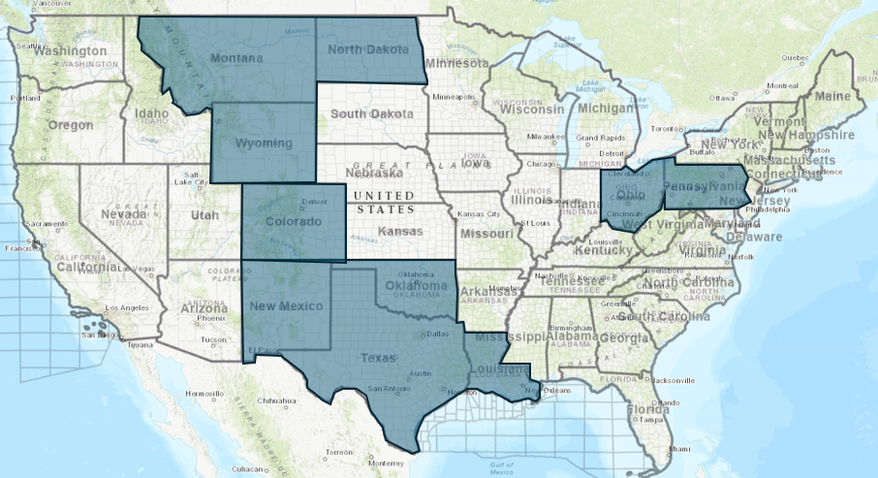
Regional & Basin Coverage
Delaware Basin (Core)
Ward, Reeves, Winkler, Loving Counties
Midland Basin
Midland, Howard, Glasscock, Reagan, Crane, Upton
[ Insert Basin Map — US Onshore Coverage ]
Rocky Mountain
Colorado, Wyoming, Montana, North Dakota
Mid-Continent
Oklahoma, Texas
Appalachia
Pennsylvania, West Virginia, Ohio

Slide 9
Let's Work Together
Areas of Support
Contact
✓ Pipeline ROW acquisition and negotiation
✓ Electrical and utility easements
Ivan Toledo, RPL
✓ Water infrastructure ROW and facility siting
Founder | 2-7 Energy Co., LLC
✓ Surface use agreements — pads, facilities, compressors
Email:
ivan_toledo@2-7energy.com
✓ Access and road corridor coordination
✓ Title and curative support for surface projects
Cell:
682-203-8688
How We Engage
Office:
682-402-5343
1
Identify project needs and timeline
2
Align on scope and support model
Web:
www.2-7energy.com
3
Complete vendor onboarding
4
Execute — integrated from day one
2-7 Energy is available now.
Reach out to align on your next project.

