Slide 1
2-7 ENERGY CO., LLC
Land, Site Control &
Infrastructure Execution
Data Centers | Power Infrastructure | Energy Development
USMC Veteran-Owned | Fort Worth, Texas | RPL Certified

Slide 2
About 2-7 Energy Co., LLC
2-7 Energy Co., LLC is a Fort Worth, Texas-based land services firm providing subsurface, surface, and development-focused land support to operators, developers, and energy companies across the Lower 48.
AAPL
Registered Professional Landman
Founded by land professionals with both in-house operator and brokerage experience, our team understands how land execution directly impacts drilling schedules, infrastructure timelines, and capital deployment.
USMC
Veteran-Owned Business
Be responsive. Solve problems early. Keep projects on schedule.
Lower 48
Nationwide Basin Experience

Slide 3
Why Texas — And Why Now
Texas is the fastest-growing data center and power infrastructure market in the United States. The land work is active — and complex.
#1
ERCOT
AI
ROW
Data center
growth market
in the US
Deregulated grid
creating power
development demand
Hyperscale buildout
driving campus-scale
site demand
Transmission
corridors critical
for power delivery
These projects require experienced land professionals who understand large-scale site control, multi-tract title, and infrastructure corridor execution.
Our O&G infrastructure background translates directly — the skills are the same. The timelines are faster.

Slide 4
Land & Site Development Services
Supporting developers and infrastructure groups from site identification through construction readiness — aligned with aggressive project timelines.
Site Control & Land Assembly
Title & Due Diligence
Acquisition and option agreements for large-scale campus sites. Coordination across multiple landowners and tracts; phased development structuring.
Ownership verification across large multi-tract positions. Title defect identification and curative to meet institutional and financing requirements.
Power & Transmission ROW
Fiber, Water & Utility ROW
Easement acquisition for transmission lines, substation sites, and power delivery corridors. Coordination with utilities and power providers.
ROW negotiation for fiber, water supply, and wastewater infrastructure. Multi-utility corridor planning and landowner alignment.
Landowner & Stakeholder Mgmt
Construction Readiness
Direct negotiation with surface owners. Conflict resolution and clear communication to maintain project momentum across large footprints.
Access agreements, staking support, and field coordination. Land deliverables sequenced to meet construction mobilization dates.

Slide 5
How Our Experience Translates
Data center and power infrastructure land work draws on the same skills as large-scale O&G development. We've done this work — in a different sector.
O&G Infrastructure Experience
Data Center / Power Application
Pipeline & gathering ROW acquisition
Transmission line and substation ROW
Multi-tract leasehold and surface assembly
Campus-scale site control across multiple landowners
Title curative for development programs
Title curative for institutional financing requirements
Electrical easements for drilling & production
Power delivery easements for data center campus
Produced water pipeline and pond siting
Fiber, water supply, and wastewater ROW
Landowner negotiation under tight timelines
Landowner negotiation under aggressive dev. schedules

Slide 6
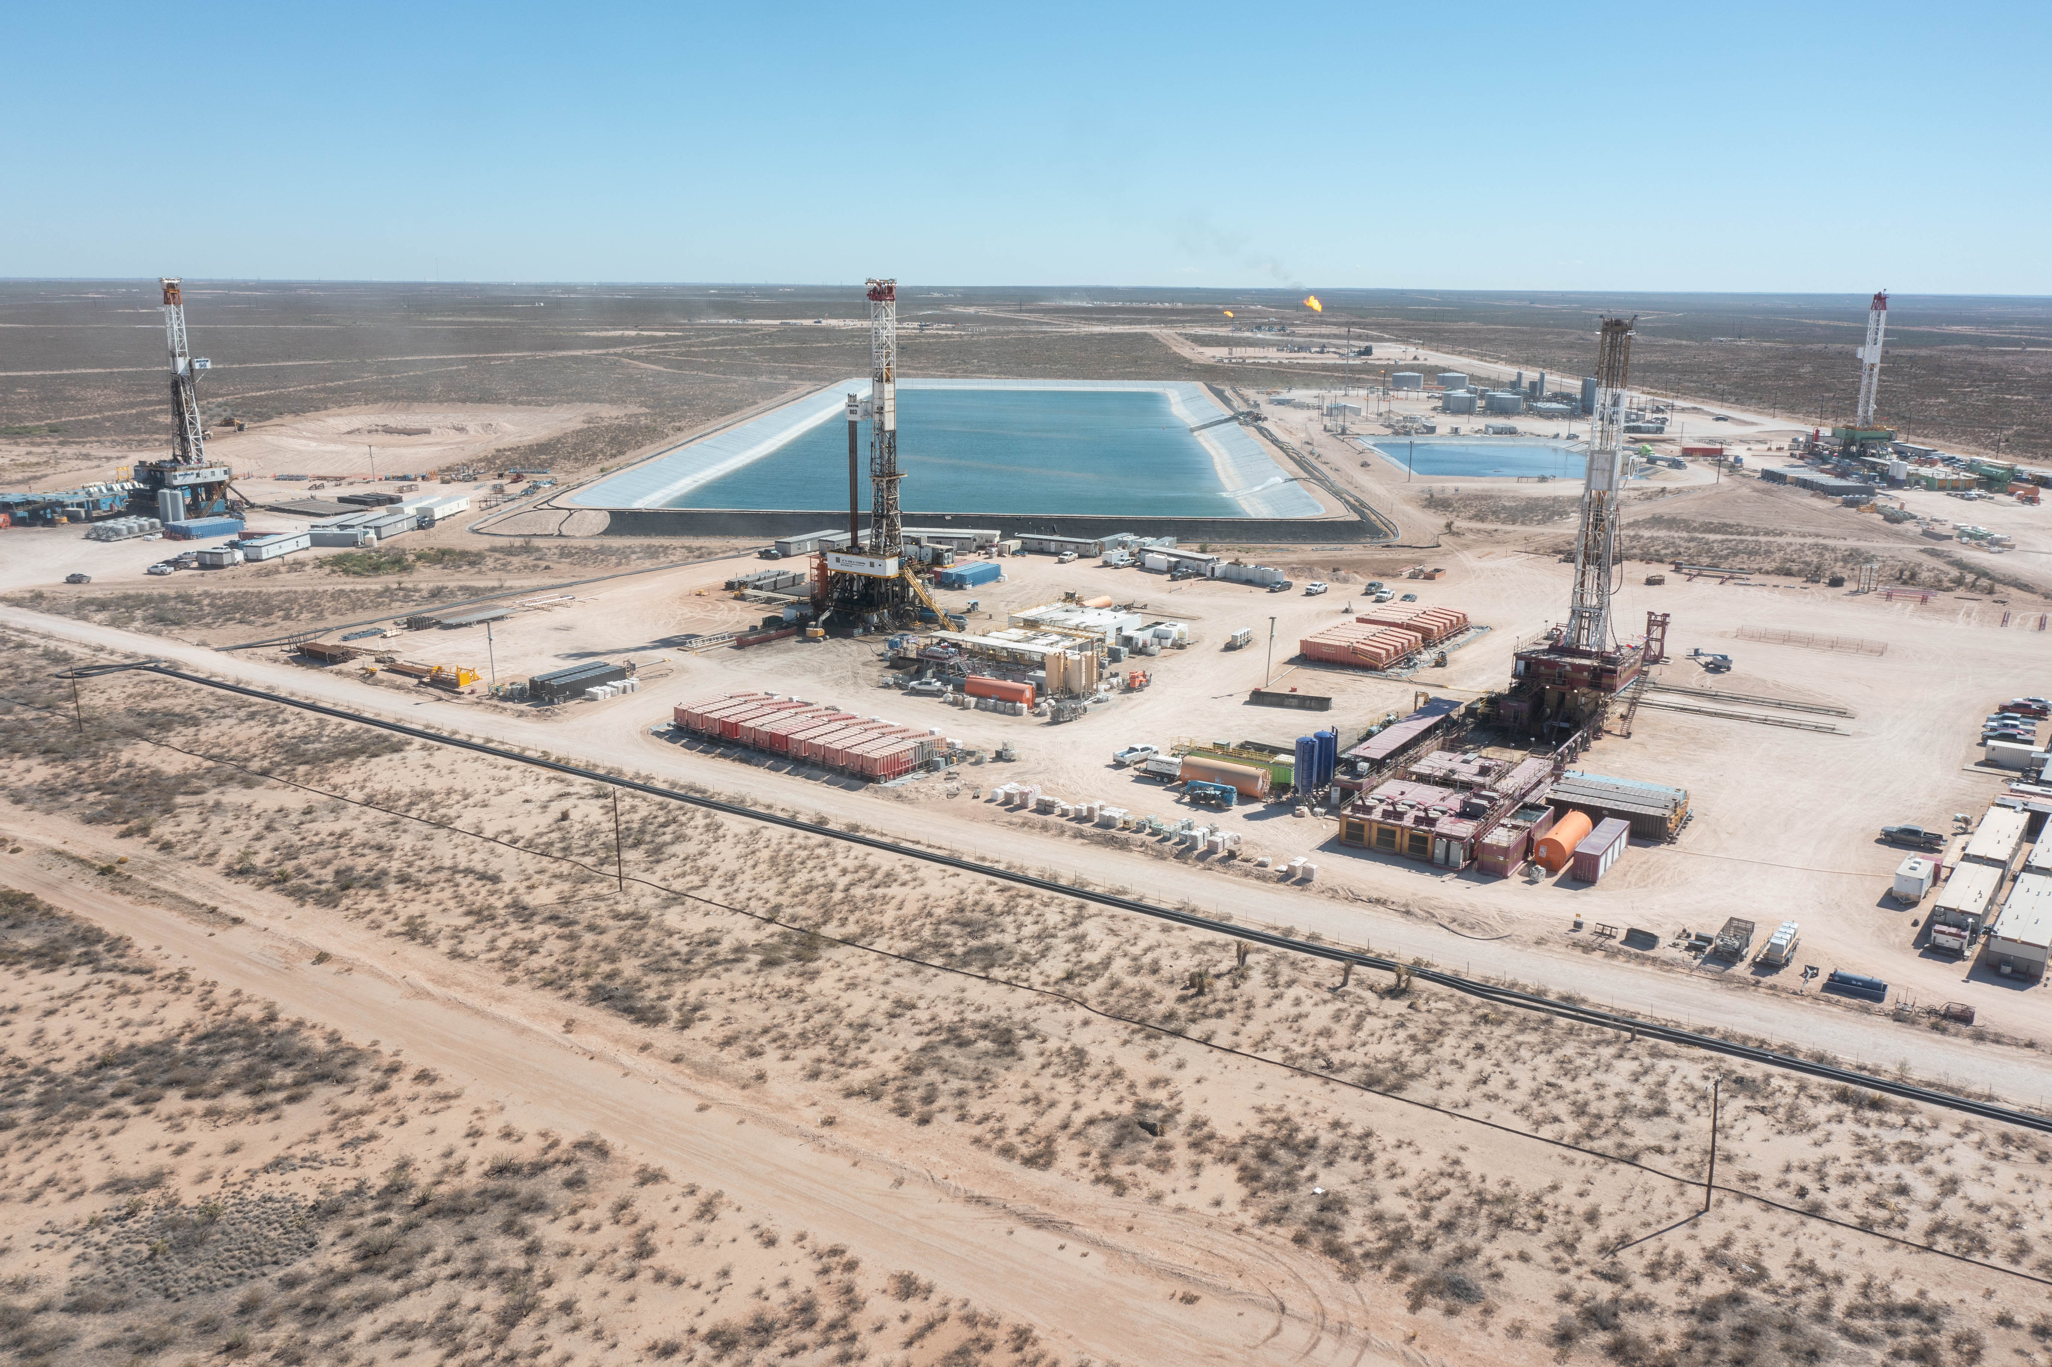
CASE STUDY
Ward County — Large-Scale Multi-Infrastructure Coordination
Project Overview
— ~350-acre integrated surface and infrastructure footprint
— Five concurrent infrastructure types coordinated
— Delaware Basin, West Texas
Scope of Work
— Multi-tract surface control across a large, fragmented landowner base
[ Insert Ward County aerial / infrastructure photo ]
— Pipeline and flowline corridor ROW across the full development area
— Electrical easement acquisition and coordination with power provider
— Water management facility siting and transfer line ROW
— Access road and logistics corridor development
Why It Matters
Demonstrates large-scale, multi-infrastructure land execution capability
Managed competing landowner interests without impacting construction schedule
Single point of coordination across engineering, legal, and operations

Slide 7
Why 2-7 Energy?
Large-Scale Site Control
Infrastructure ROW Depth
Title & Institutional Standards
Experienced coordinating land assembly and surface agreements across multi-tract, multi-landowner footprints under aggressive timelines.
We've executed ROW for pipelines, electrical, water, and access simultaneously — the same skill set data center campuses require.
Title review and curative experience aligned with development timelines and financing requirements.
Execution-Focused
Stakeholder Management
Flexible Engagement
We don't slow projects down. Land deliverables are sequenced to meet construction mobilization dates — not after.
Direct landowner negotiation and conflict resolution. We protect your project and your reputation in the communities you're entering.
Project-based or embedded support. We integrate with developer, engineering, and legal teams from day one.

Slide 8
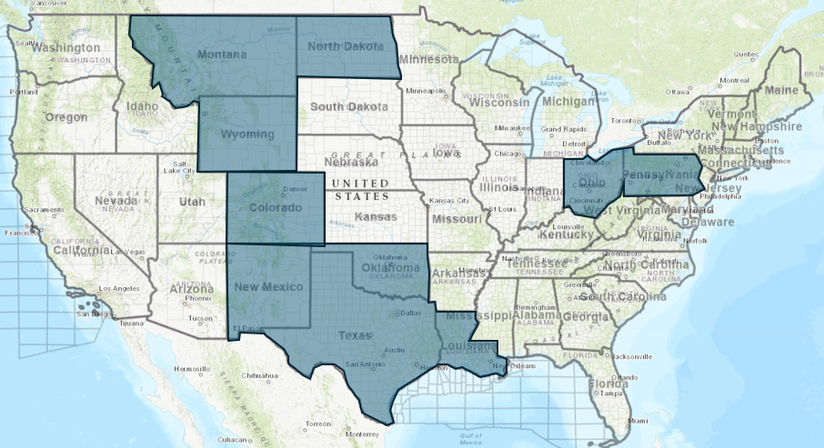
Project Coverage
North Texas / DFW
Data center corridor, power infrastructure, transmission ROW
West Texas (Permian)
Power generation, large-scale site control, transmission corridors
Gulf Coast / Houston
[ Insert Texas / Regional Coverage Map ]
Energy infrastructure, industrial development support
Statewide
Scalable support across Texas; multi-state capability available
Lower 48
National project exposure through O&G and infrastructure programs

Slide 9
Let's Work Together
Areas of Support
Contact
✓ Site acquisition and land assembly
✓ Title, due diligence, and curative
Ivan Toledo, RPL
✓ Transmission and power delivery ROW
Founder | 2-7 Energy Co., LLC
✓ Fiber, water, and utility easements
Email:
ivan_toledo@2-7energy.com
✓ Landowner negotiation and conflict resolution
✓ Construction readiness and access coordination
Cell:
682-203-8688
How We Engage
Office:
682-402-5343
1
Identify project needs and timeline
2
Align on scope and support model
Web:
www.2-7energy.com
3
Complete vendor onboarding
4
Execute — integrated from day one
2-7 Energy is available now.
Reach out to align on your next project.

